Slide 1
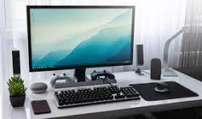
computer

Slide 2
What is computer ?
A computer is an electronic device that manipulates information, or data. It has the ability to store, retrieve, and process data. You may already know that you can use a computer to type documents, send email, play games, and browse the Web.
What is full form of computer ?
Full Form of Computer is “Common Operating Machine Purposely Used for Technological and Educational Research.

Slide 3
Types of computer
There are many different types of computers, but here are 5 of the most common Computer: Supercomputers, Mainframe computers, Minicomputers, Personal computers (PCs), Microcontrollers.
.Supercomputer
A supercomputer is a type of computer with a high level of performance as compared to a general-purpose computer.
.mainframe
computers that have a lot of memory and processors, so they can do billions of transactions and simple calculations in real time.

Slide 4
.minicomputer
computer that was smaller, less expensive, and less powerful than a mainframe or supercomputer but more expensive and more powerful than a personal computer.
.persnol computer
computer that was smaller, less expensive, and less powerful than a mainframe or supercomputer but more expensive and more powerful than a personal computer.
.microcontroller
A microcontroller (MC, UC, or μC) or microcontroller unit (MCU) is a small computer on a single integrated circuit. A microcontroller contains one or more CPUs (processor cores) along with memory and programmable input/output peripherals.

Slide 5
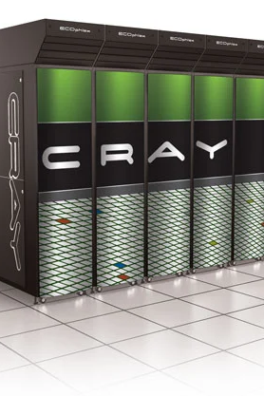
What is the first super computer name ?
The CDC 6600 is considered the first supercomputer. It was designed by Seymour Cray – often considered the father of supercomputing – while he was working at the Control Data Corporation (CDC).

Slide 6
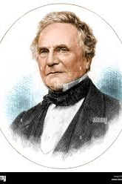
.Who is the father of computer ?
= Charles babbage

